Slide 1

Winter crisis and impact of Covid - 19
Lloyd Lombardi
Neil Plenderleith
Nicolo Mastronardi
Jamie Zike

Slide 2
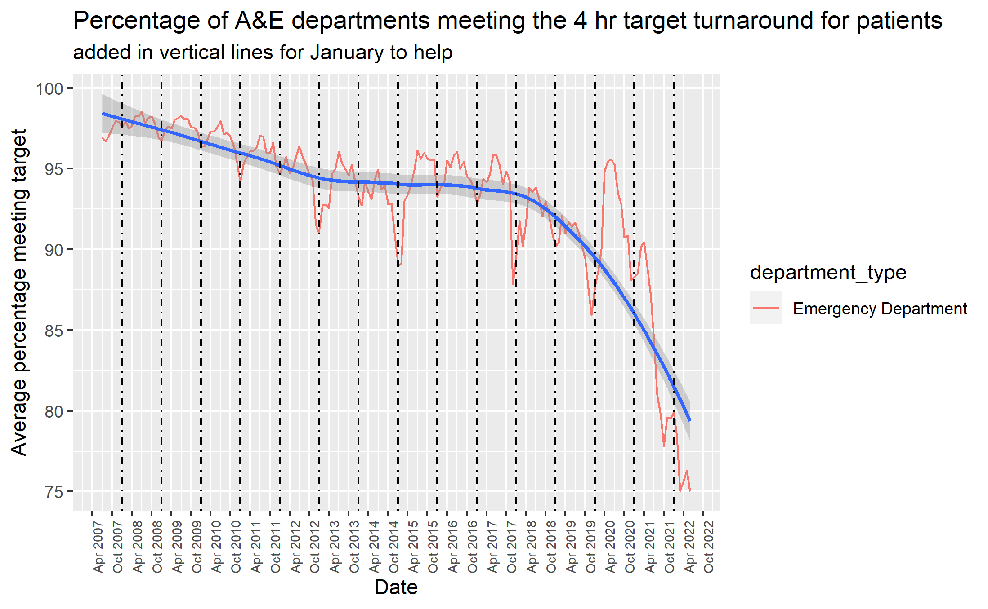
NHS winter crisis
Perennial issue resulting from increase in season-specific medical problems (Lawson & Lovatt, 2020)
4 hour target turnaround is the most common metric
Notes:
Covers months Dec, Jan, Feb

